Slide 1
Nerdy Nets – GPT2

Slide 2
Model Overview
Query Algorithm
Transformer/LSTM algorithm
GPT-2 algorithm
Model loss
GPT-2 loss
Original paragraph (400 words)
Generated paragraph (400 words)
Generated summary (100 words)

Slide 3
Preprocess
TLDR reddit dataset
Paragraph’s cleaned and padded to paragraph_window_size (100)
Summaries cleaned and padded to summary_window_size (100)

Slide 4
Query Algorithm

Slide 5
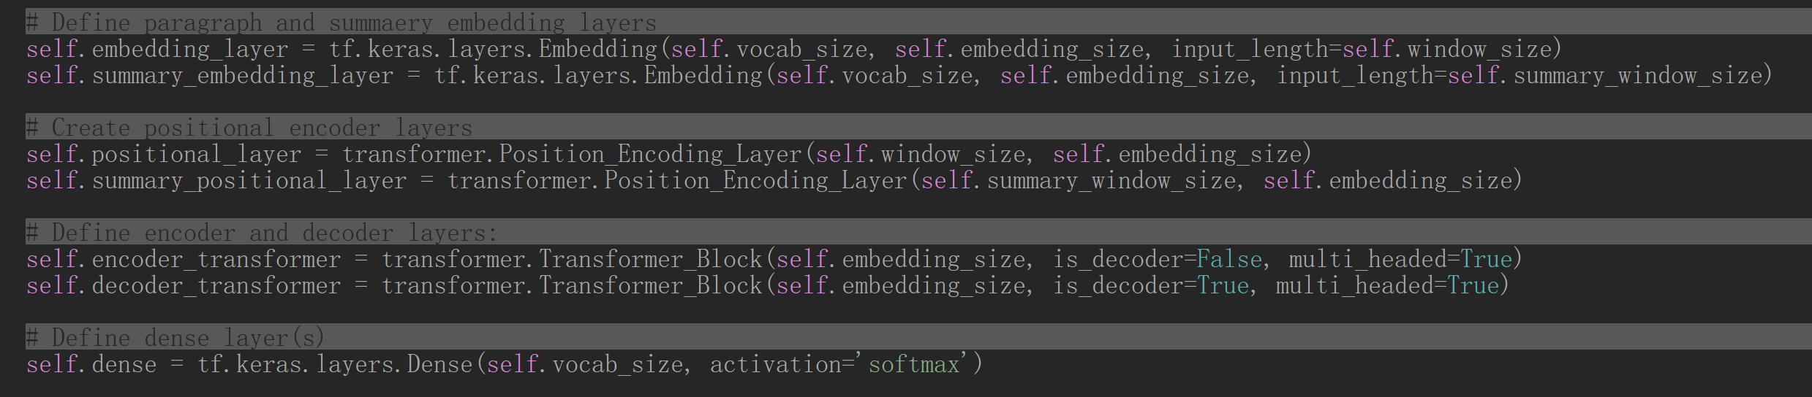
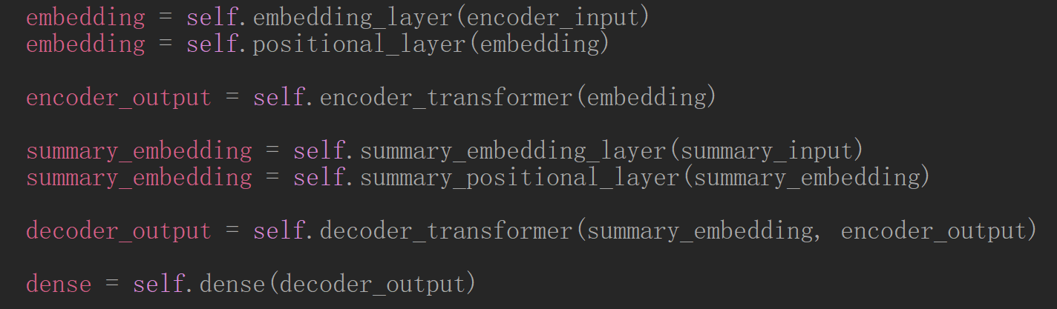
Transformer Algorithm
sizes
Encoder size = decoder size = 15
Window size = summary window size = 100
Vocab size = 717515

Slide 6
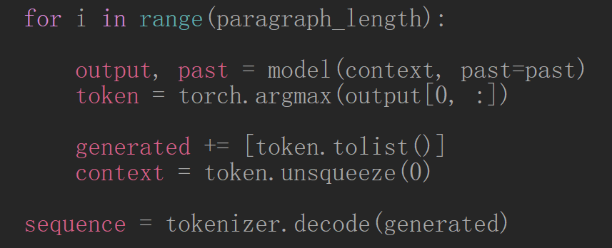
GPT-2 Algorithm
OpenAI GPT-2 model 124M parameter model (smallest) trained on 40GB of text data

Slide 7
Results

Slide 8
GPT-2 example

Slide 9
Discrepencies
Paragraph window size should be larger than summary window size

